Slide 1
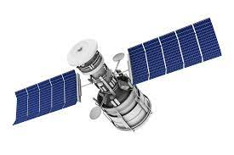
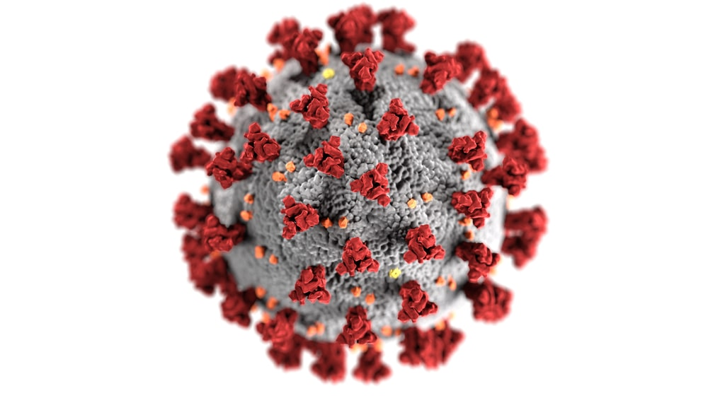
Pandemic Impact on LULC
Sagar Malik

Slide 2
Table of contents
Objective
Introduction
Tools and Techniques
Data Gathering
Preprocessing
Classification
Change Analysis
Result and Conclusions.

Slide 3
Objective
The COVID-19 outbreak and the resulting social distancing recommendations and related restrictions have led to numerous short-term changes in economic and social activity around the world, all of which may have impacts on our environment. Your challenge is to use space-based data combined with ground observations and document all the environmental changes caused by COVID-19 and the associated societal responses.
Your goal is to use space-based satellite data combined with ground observations like air pollution, social-economic activity, traffic or transportation, mobility, industrial activity perform exploratory data analysis, find a correlation between changes in ground activities and their impact on the environment. Compare data across different time periods and geographic regions and explore changes in Earth-related attributes (such as land use, land cover, and other characteristics) in response to COVID-19?

Slide 4
Introduction
The pandemic has been hard to majority of the population, restricting everyone to stay home. But not all impacts of the pandemic were negative.
The nature heals itself when left untouched.
We will deep dive how much of the Land cover have been transformed during the lockdown period and calculate the change analysis.

Slide 5
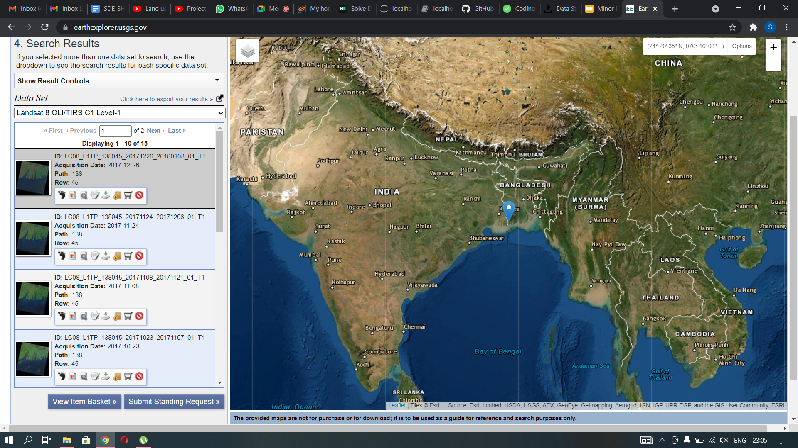
Data Gathering Using USGS:
Using USGS EarthExplorer we gathered high quality images of sundarbans.
Data taken for this study is from 2019 - 2022.

Slide 6
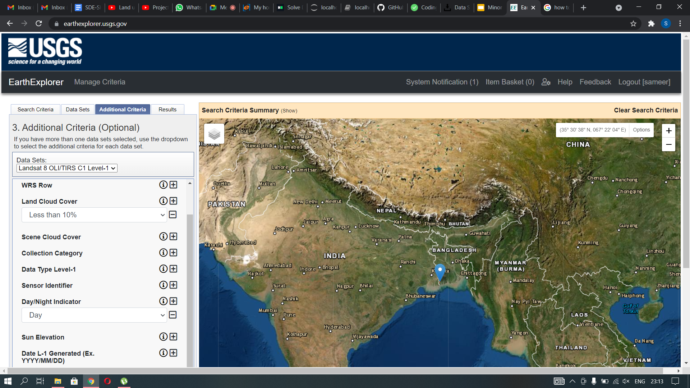
2. Data Filtering
Filtering the images generated on the basis of 2 categories:
DAY/NIGHT : Fetching the images in day time to get more clarity in the images.
CLOUD COVER : Keeping the cloud cover percentage less than 10% again for getting high clear images.

Slide 7
3. Data Preprocessing:
STEPS INVOLVED:
DATA LOADING ON JUPYTER NOTEBOOK
ANALYZING DIFFERENT BAND SETS
GETTING BAND-4 AND BAND-5 IMAGES TO FIND NDVI INDEX
CLASSIFYING IMAGE INTO 3 CATEGORIES:
BARE-LAND [0.2 TO 0.3 NDVI INDEX]
VEGETATED [0 TO 0.6 NDVI INDEX]
NO VEGETATION [0 NDVI INDEX]

Slide 8
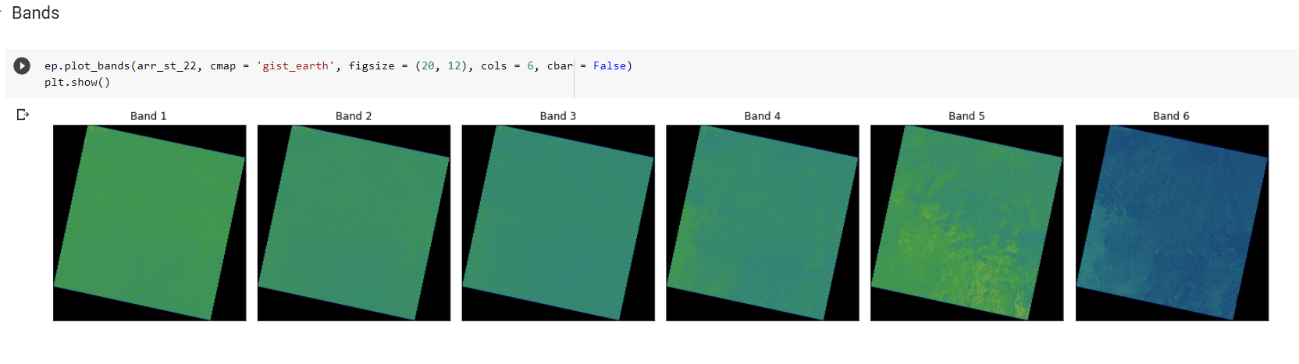
Band Images:

Slide 9
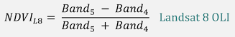
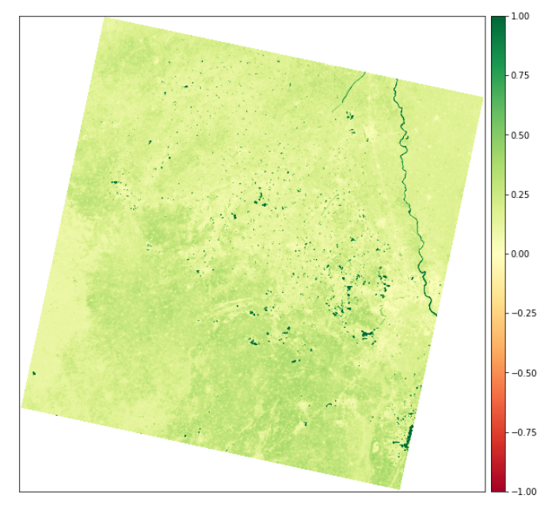
NDVI Index Calculations:
What is NDVI ?
Normalized difference vegetation index
Mathematical formula derived to form a single spectral based number
(more sensitive than just a single wavelength)
Ratio - no units

Slide 10
Data Implementation:
In reference to legend systems for land-cover mapping, such as the United States Geographical Survey (USGS) Land Use/Land Cover System Legend, here we have classified the image broadly into three legends(categories): Bare Land(crop land), Vegetation, No vegetation (As they were the majority and covered more than 95 percent of the study area). More details are mentioned below.

Slide 11
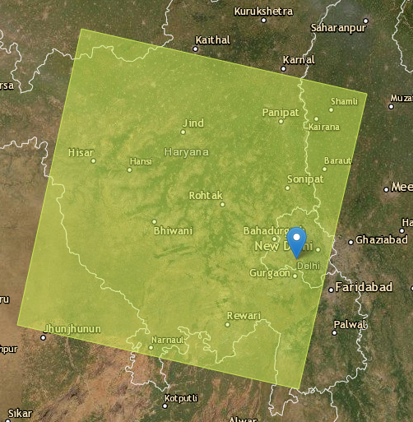
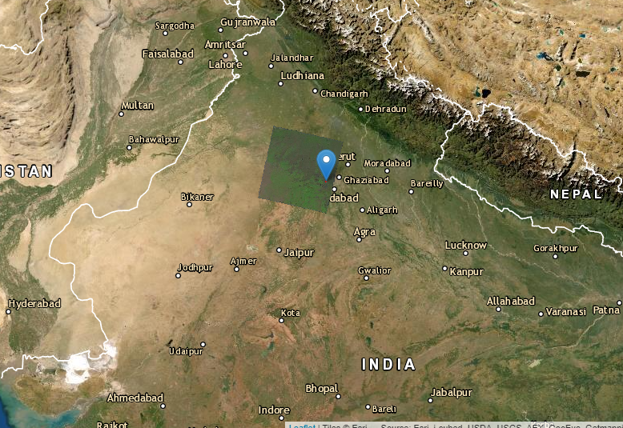
Study Area:
Northern Patch covering Delhi & Nearby major cities
In Haryana & UP

Slide 12
Land Cover Classes :
Land cover/ class | Description
Vegetation | Area consisting of trees, plants, shrubs, any kind of vegetation etc.
Bare/Crop Land | Land covered with agricultural crops.
No Vegetation | Residential, industrial and commercial complexes, (any area without vegetation).

Slide 13
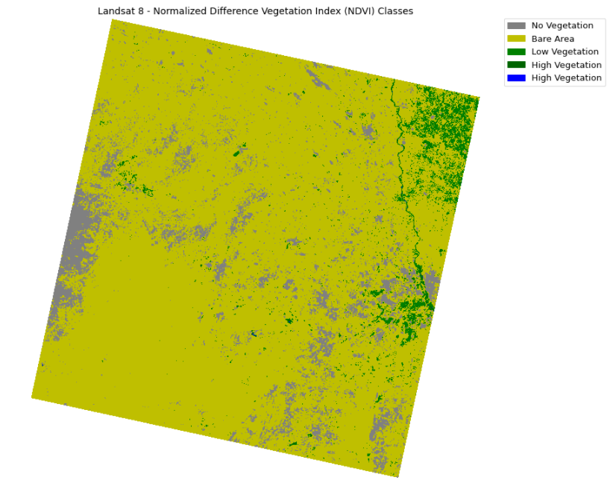
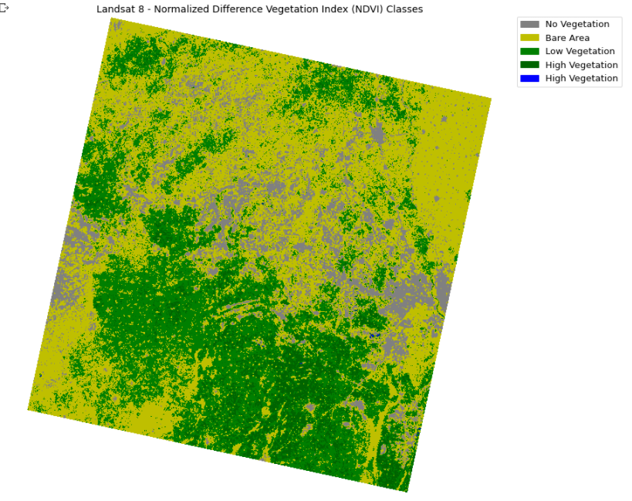
Pixel Based Classification:
Deep vegetation cannot grow in a span of 2 years, but some pixels were found, thus having a very small area.
(Can Identified in notebook code)
(2019)
(2022)

Slide 14
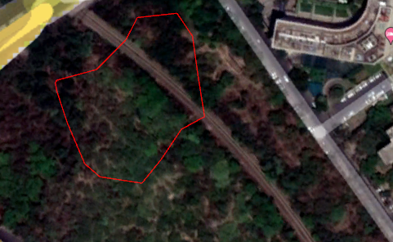
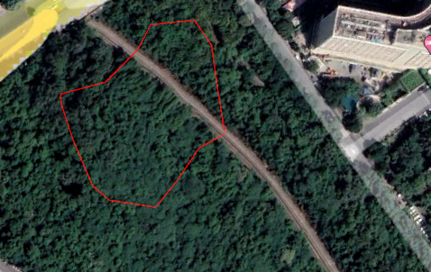
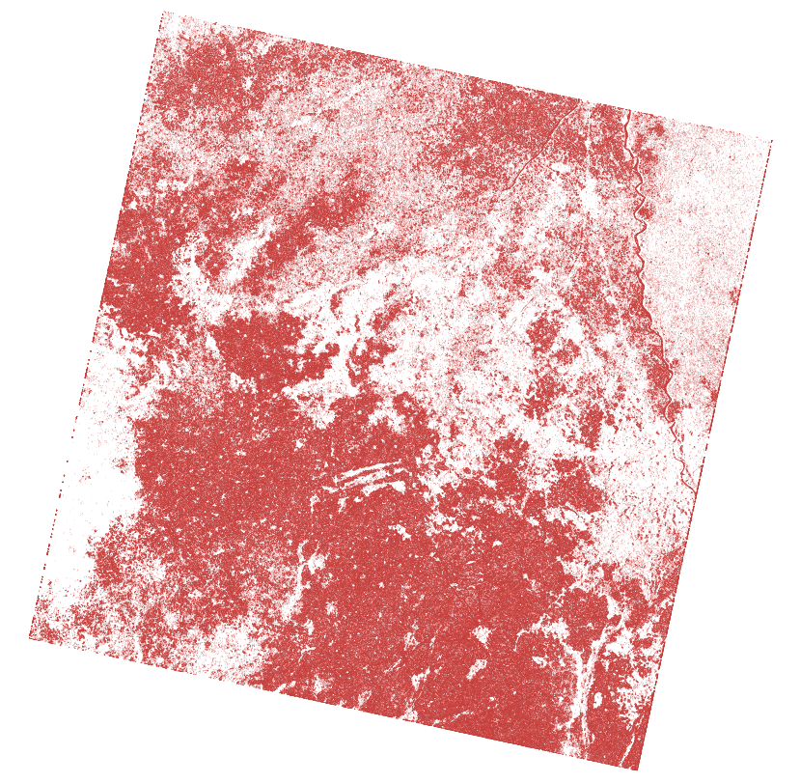
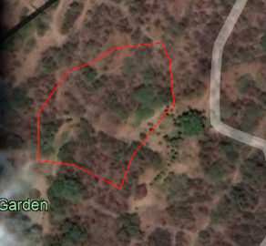
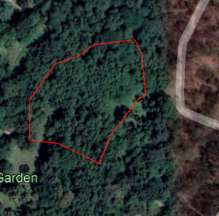
Change Analysis:
(2019)
(2022)
(Raw shapefile of the change in NDVI from 2019 - 2022)
(2019)
(2022)

Slide 15
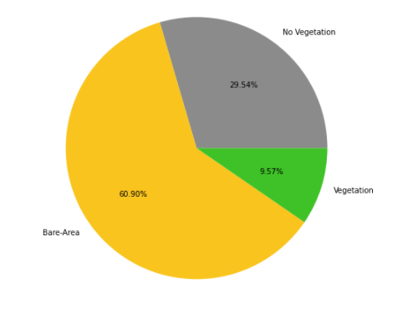
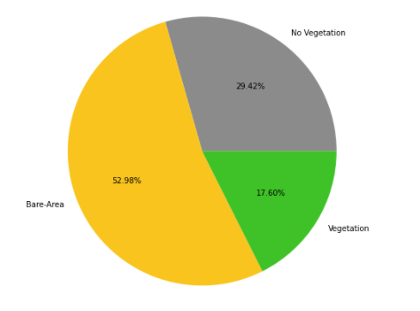
(2019)
(2022)
With the help of K Means, the classification concluded that we had an increase during the pandemic period.

Slide 16
Conclusion:
With the power of Data Analytics combined with Machine Learning in the end, gave out results clearing pointing towards the positive relation of the pandemic period towards the Vegetation in and near NCT (National Capital Territory).
From 2019/05 - 2022/01 - there had been an increase of around 8 percent.

Slide 17
Thank You

